Slide 1

Hiring Process Analytics

Slide 2

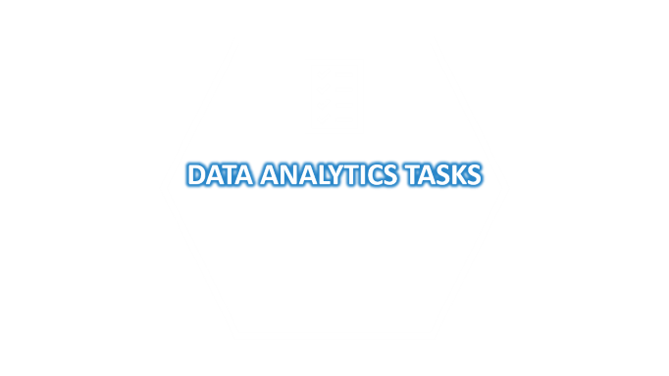
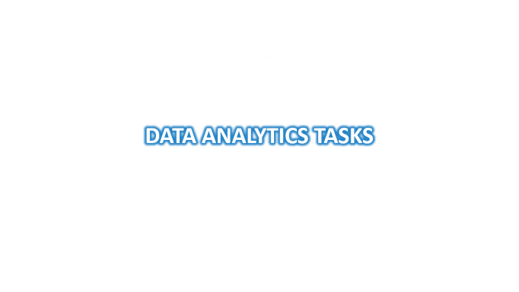
Data Analytics Tasks:
A. Hiring Analysis: The hiring process involves bringing new individuals into the organization for various roles.
Task: Determine the gender distribution of hires. How many males and females have been hired by the company?
B. Salary Analysis: The average salary is calculated by adding up the salaries of a group of employees and then dividing the total by the number of employees.
Task: What is the average salary offered by this company? Use Excel functions to calculate this.
C. Salary Distribution: Class intervals represent ranges of values, in this case, salary ranges. The class interval is the difference between the upper and lower limits of a class.
Task: Create class intervals for the salaries in the company. This will help you understand the salary distribution.
D. Departmental Analysis: Visualizing data through charts and
plots is a crucial part of data analysis.
Task: Use a pie chart, bar graph, or any other suitable visualization
to show the proportion of people working in different departments.
E. Position Tier Analysis: Different positions within a company often
have different tiers or levels.
Task: Use a chart or graph to represent the different position tiers
within the company. This will help you understand the distribution
of positions across different tiers.

Slide 3


DATA ANALYTICS TASKS

Slide 4

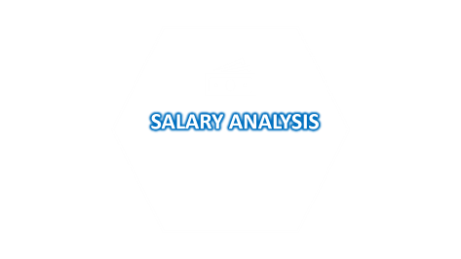
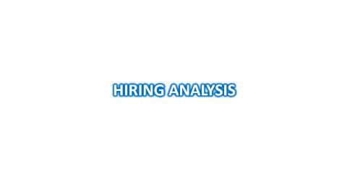
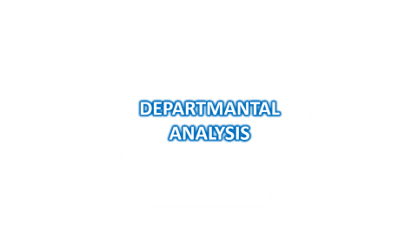



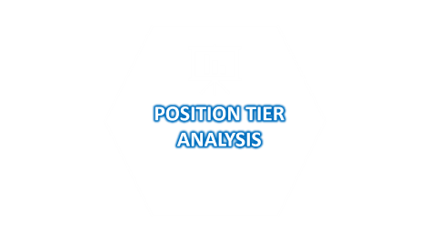


DATA ANALYTICS TASKS

Slide 5


HIRING ANALYSIS

Slide 6

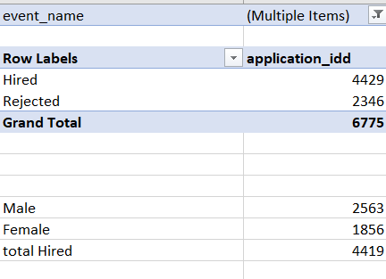
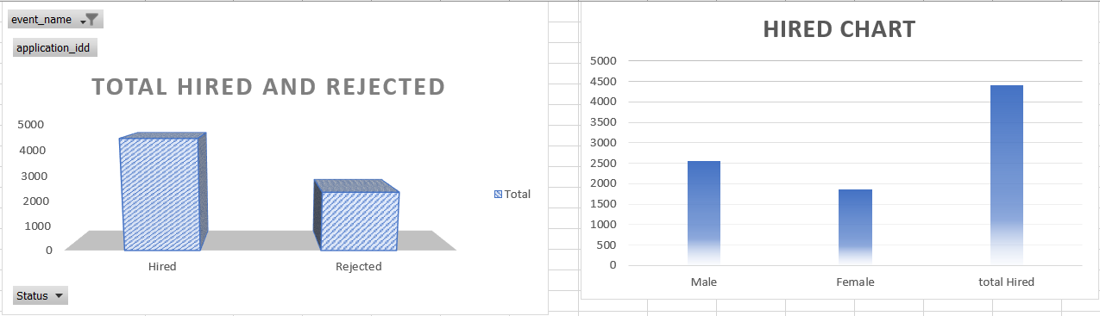
HIRING ANALYSIS

Slide 7


SALARY ANALYSIS

Slide 8
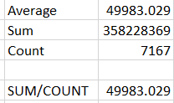
SALARY ANALYSIS
=AVERAGE(Sum/Count)
49983

Slide 9

SALARY DISTRIBUTION

Slide 10
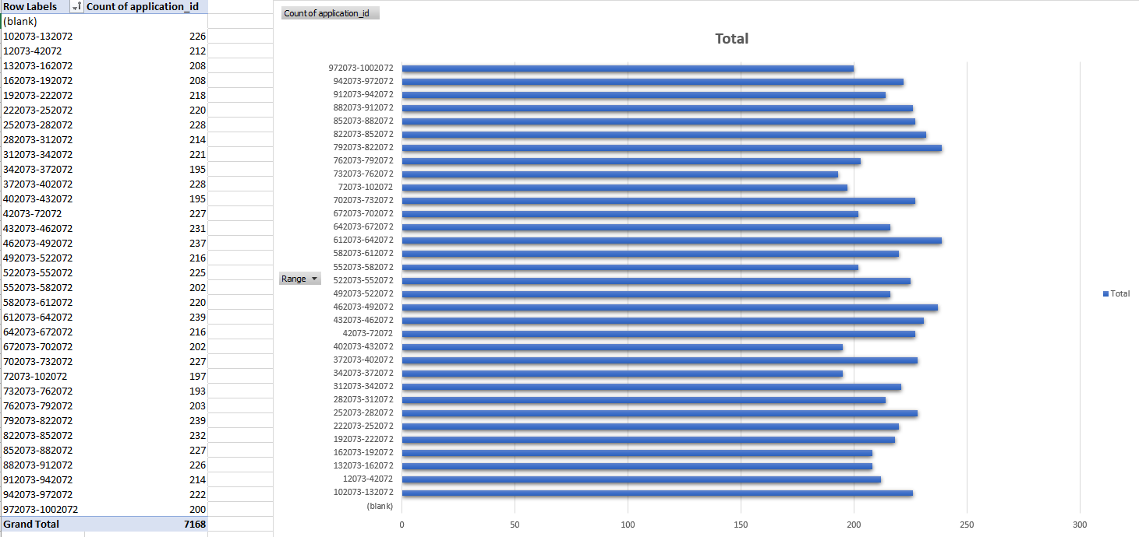
SALARY DISTRIBUTION

Slide 11

DEPARTMANTAL ANALYSIS

Slide 12
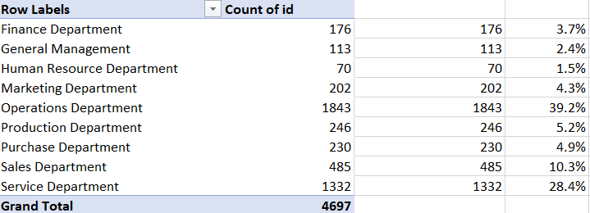
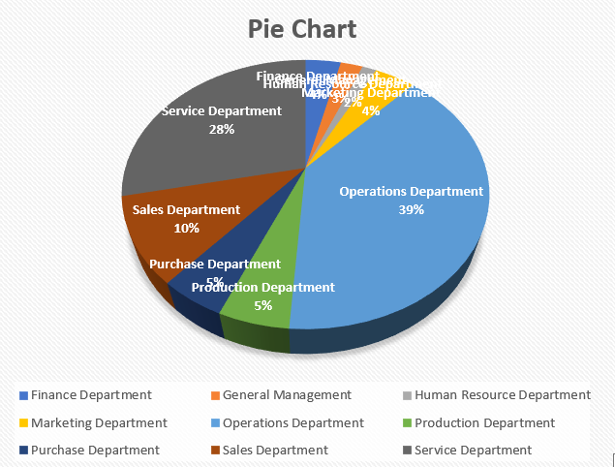
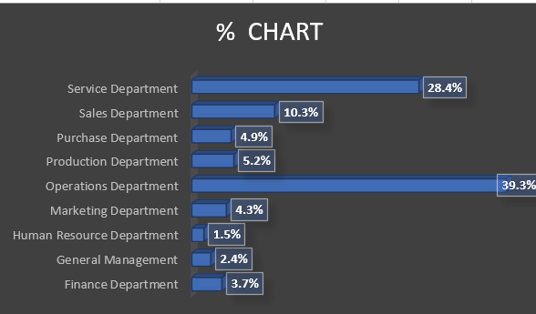
DEPARTMANTAL ANALYSIS

Slide 13

POSITION TIER ANALYSIS

Slide 14
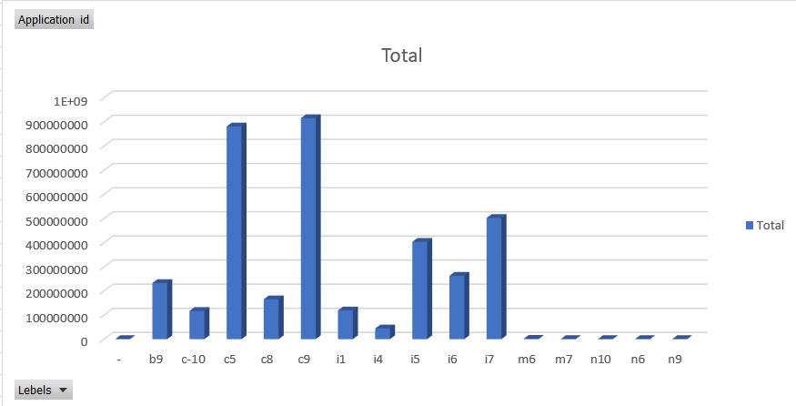
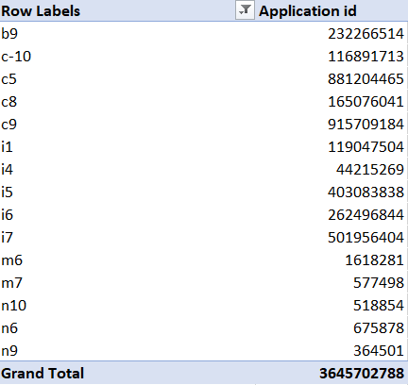
POSITION TIER ANALYSIS

Slide 15

Objectives: The project aims to analyze the hiring process data of a multinational company (similar to Google) to draw meaningful insights. The primary objectives include understanding the gender distribution of hires, calculating the average salary, visualizing salary distribution, exploring departmental proportions, and examining position tier distribution.
Approach:
Data Cleaning, 2.Hiring Analysis (Gender Distribution),3.Salary Analysis (Average Salary),4.Salary Distribution (Class Intervals),5.Departmental Analysis,6.Position Tier Analysis,7.Data Summary
CONCLUSION
Key Insights
1.Gender Distribution,2.Average Salary,3.Salary Distribution,4.Departmental Proportions,5.Position Tier Analysis.
.
Tech-Stack Used:- Microsoft Excel 2022
Result
These actionable insights for the company to enhance its hiring processes, foster inclusivity, and maintain competitive talent acquisition practices. The project serves as a foundation for informed decision-making and continuous improvement in recruitment strategies.

Slide 16
CONCLUSION
Objectives: The project aims to analyze the hiring process data of a multinational company (similar to Google) to draw meaningful insights. The primary objectives include understanding the gender distribution of hires, calculating the average salary, visualizing salary distribution, exploring departmental proportions, and examining position tier distribution.
Approach:
Data Cleaning, 2.Hiring Analysis (Gender Distribution),3.Salary Analysis (Average Salary),4.Salary Distribution (Class Intervals),5.Departmental Analysis,6.Position Tier Analysis,7.Data Summary
Key Insights
1.Gender Distribution,2.Average Salary,3.Salary Distribution,4.Departmental Proportions,5.Position Tier Analysis.
.
Tech-Stack Used:- Microsoft Excel 2022
Result
These actionable insights for the company to enhance its hiring processes, foster inclusivity, and maintain competitive talent acquisition practices. The project serves as a foundation for informed decision-making and continuous improvement in recruitment strategies.

Slide 17
THANK YOU
SURAJ KUMAR

